Slide 1
Different plot.heights

Slide 2
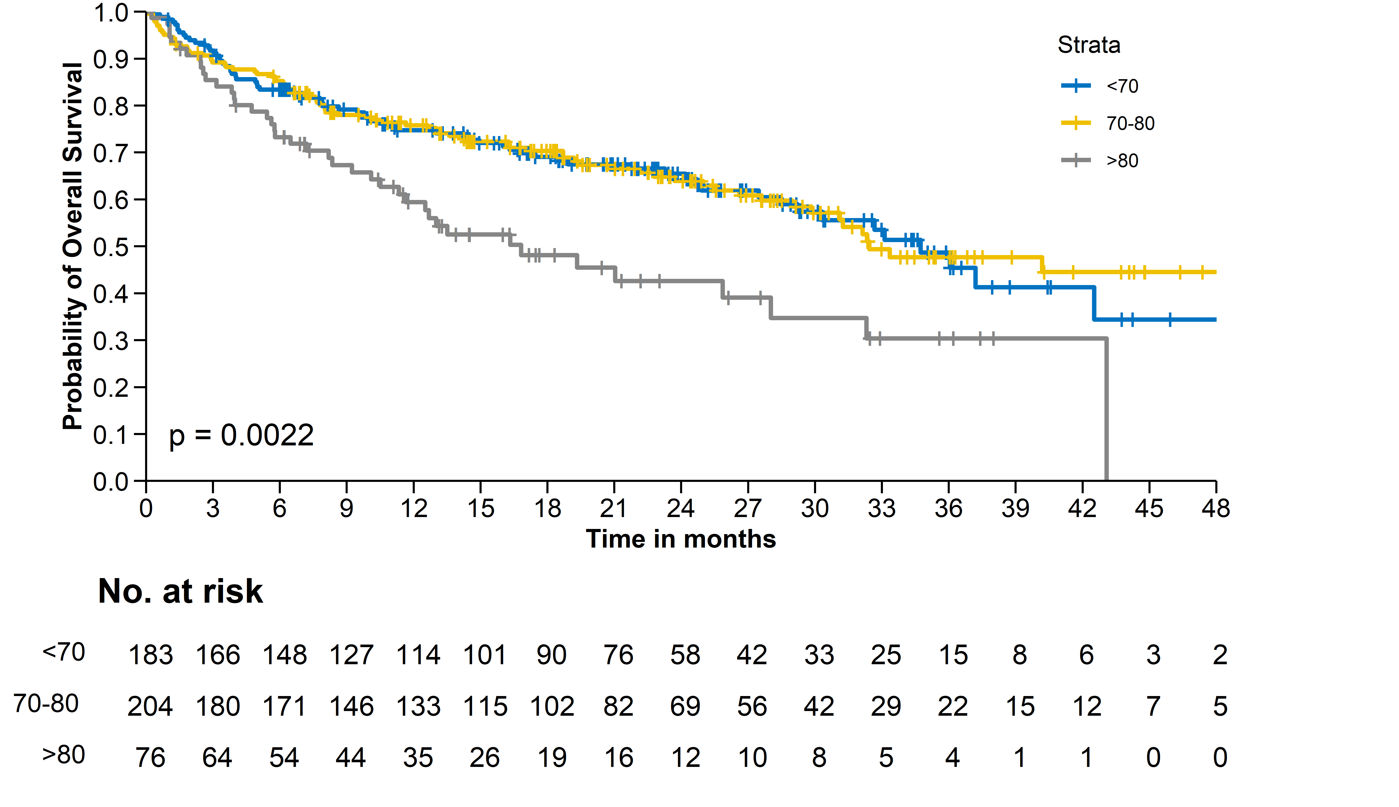
Plot.height = 0.7
Legend.position = c(0.9, 0.8)

Slide 3
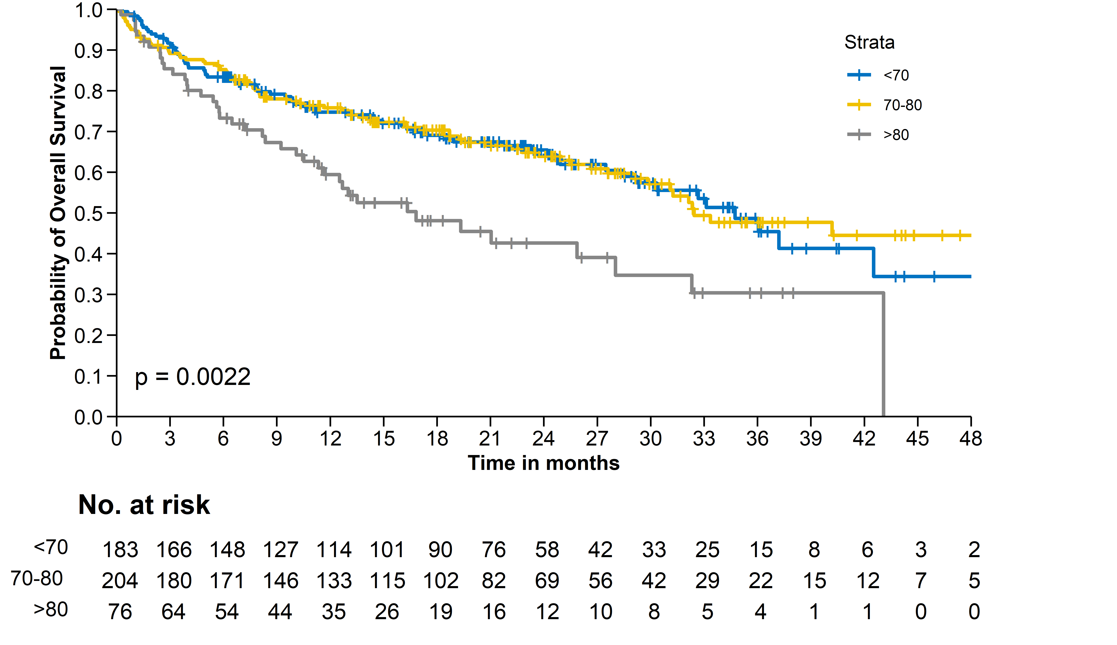
Plot.height = 0.75
Legend.position = c(0.9, 0.8)

Slide 4
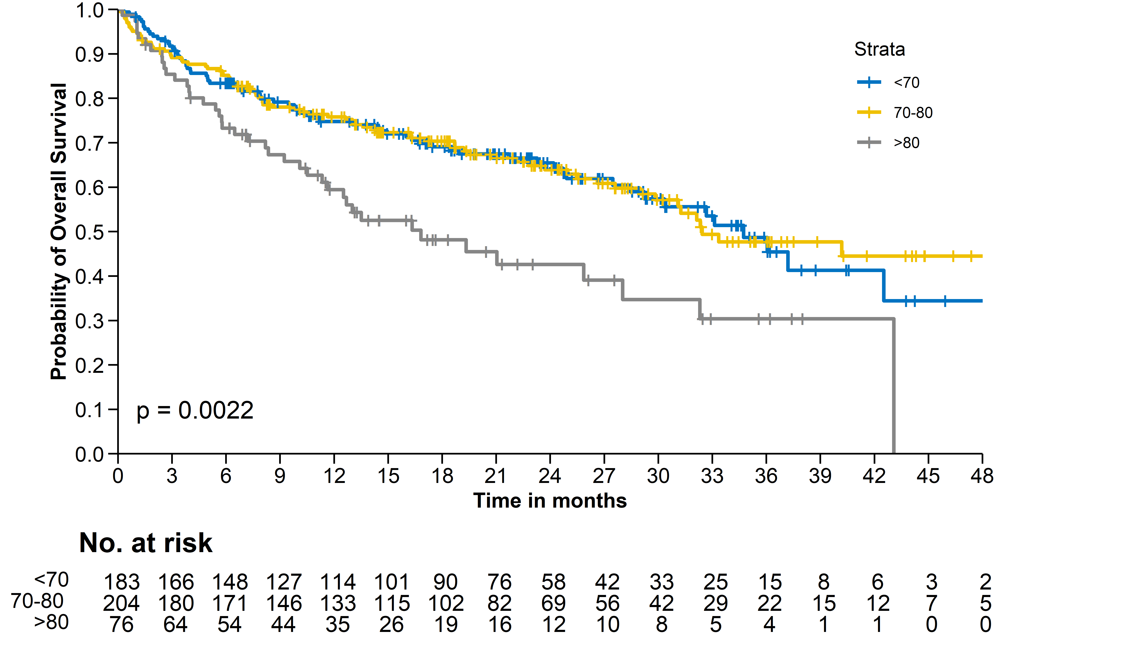
Plot.height = 0.8
Legend.position = c(0.9, 0.8)

Slide 5
Different legend positions

Slide 6
Plot.height = 0.7
Legend.position = c(0.9, 0.8)

Slide 7
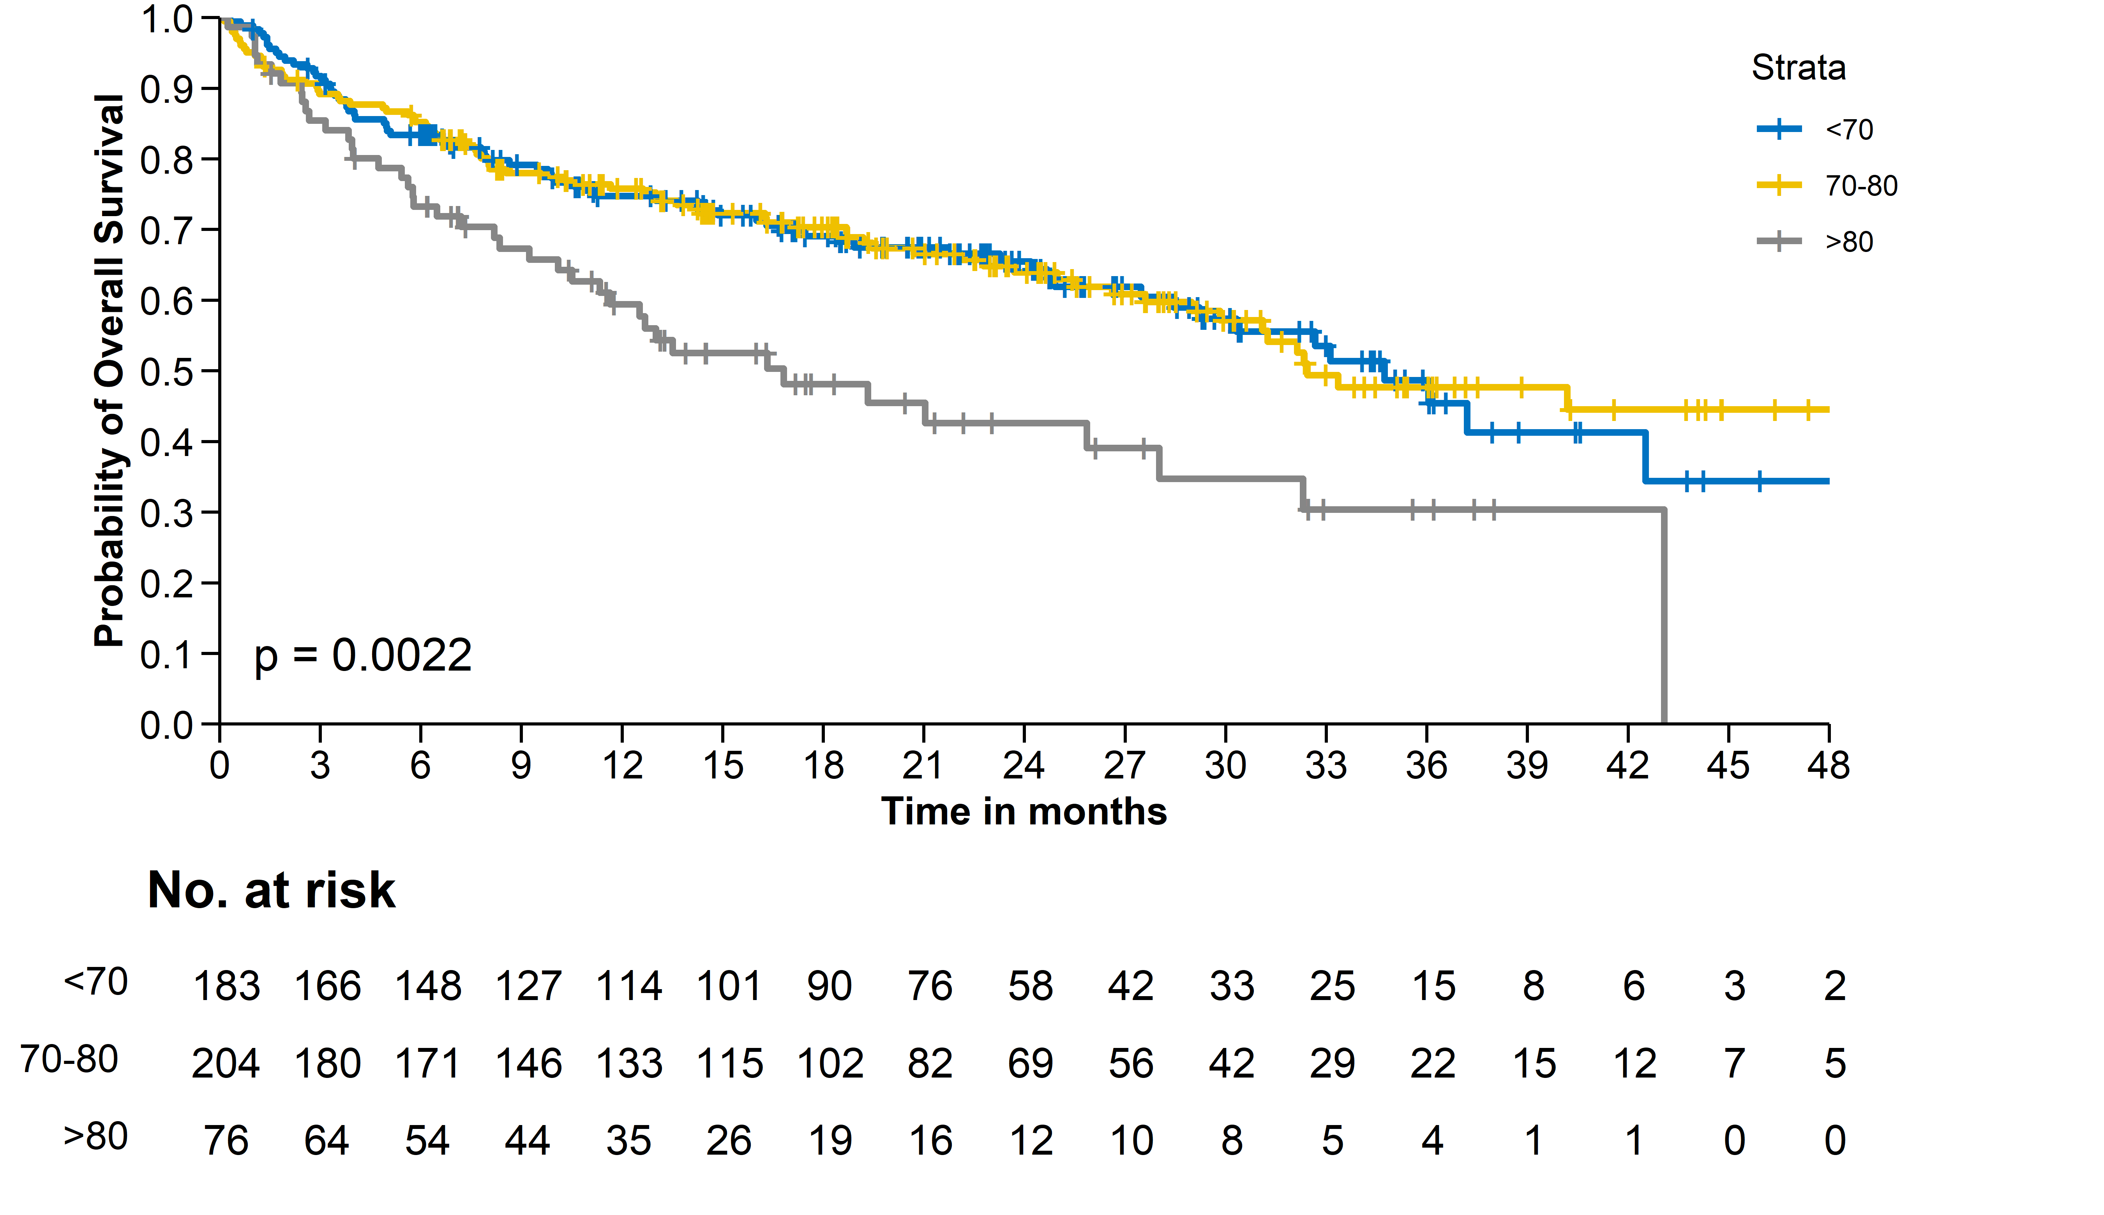
Plot.height = 0.7
Legend.position = c(1, 0.8)

Slide 8
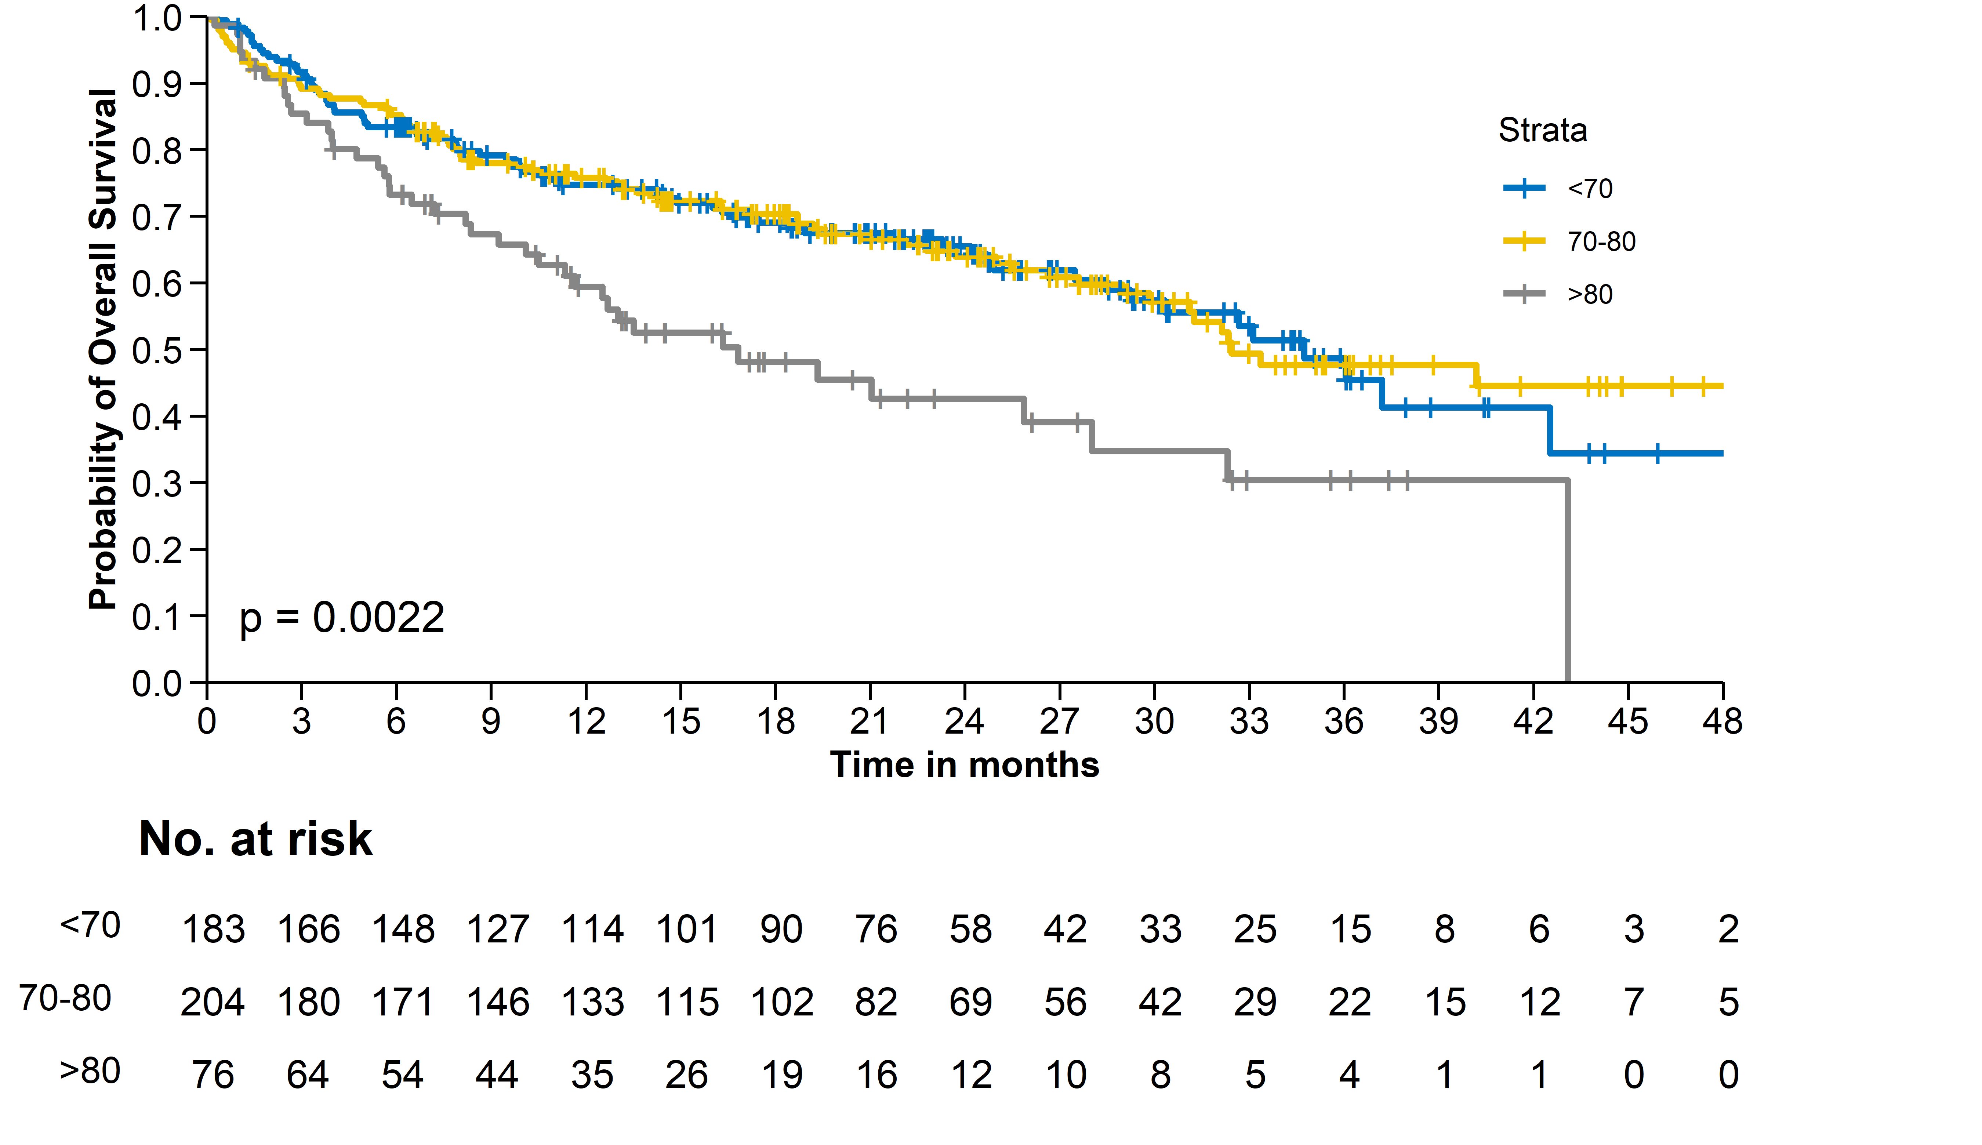
Plot.height = 0.7
Legend.position = c(0.9, 0.7)

Slide 9
Legend position „right“ caveat

Slide 10
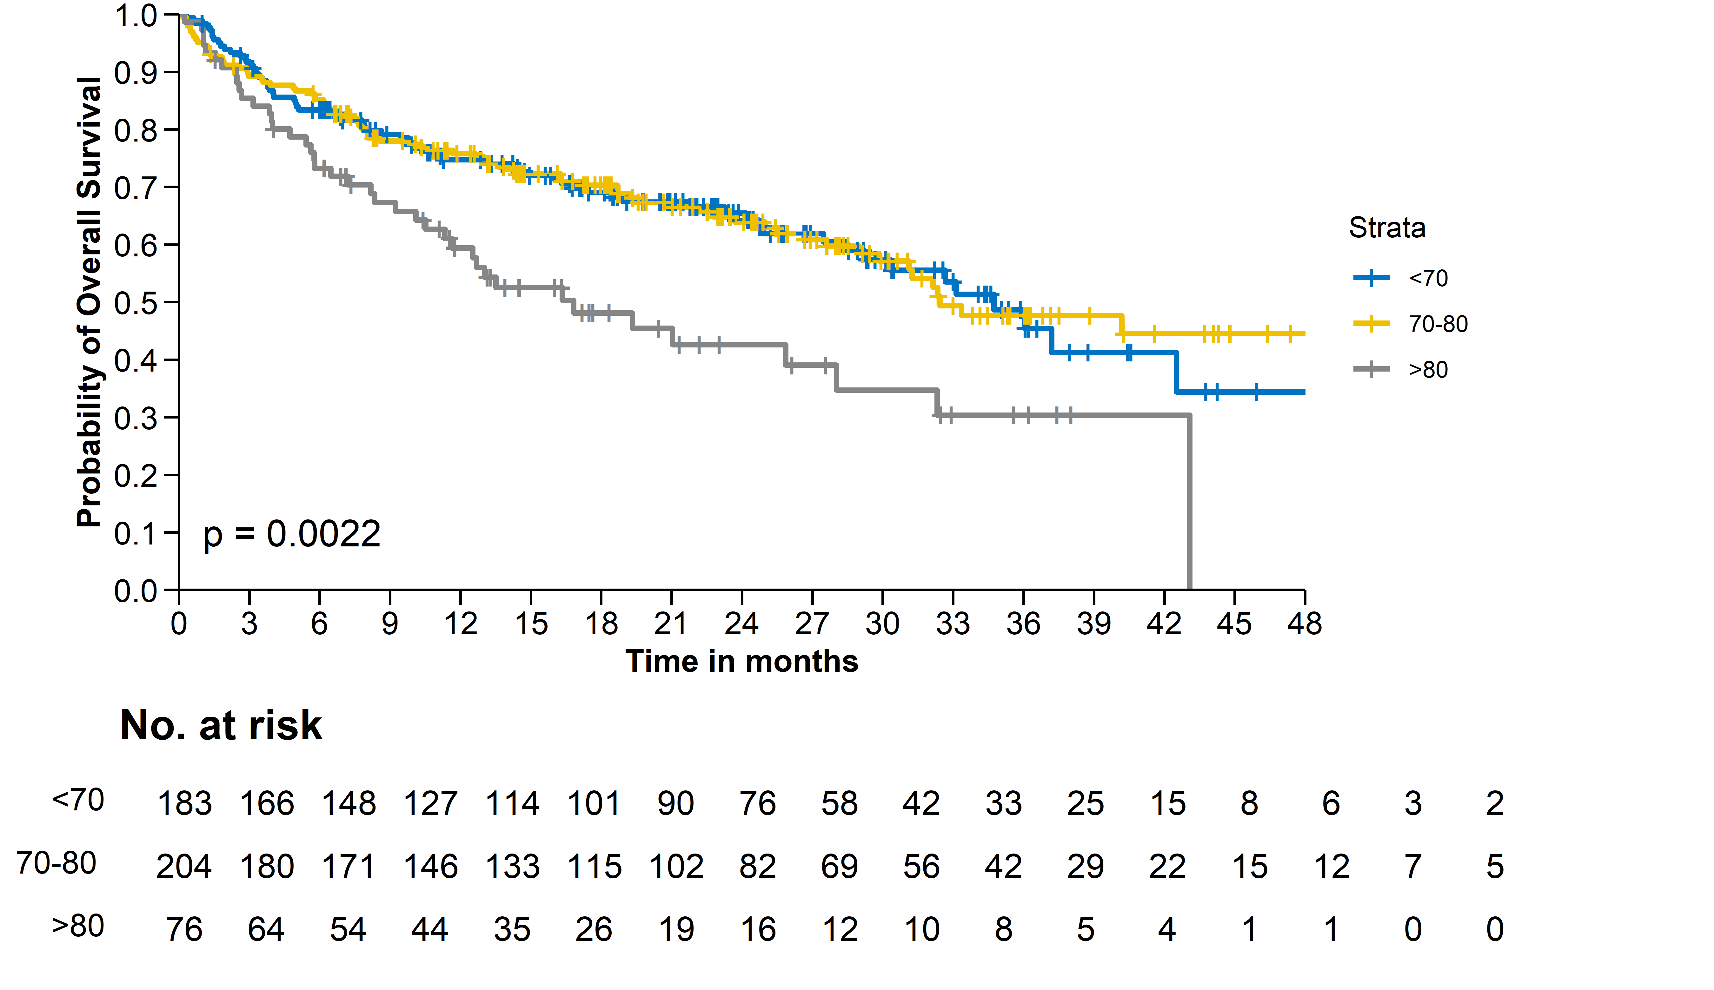
Plot.height = 0.7
Legend.position = „right“
Risk.table.width = 0.92
The default risk.table.width (0.92) is for legend.position = „top“
Has to be adjusted accordingly if legend.position = „right“ (see next slide)

Slide 11
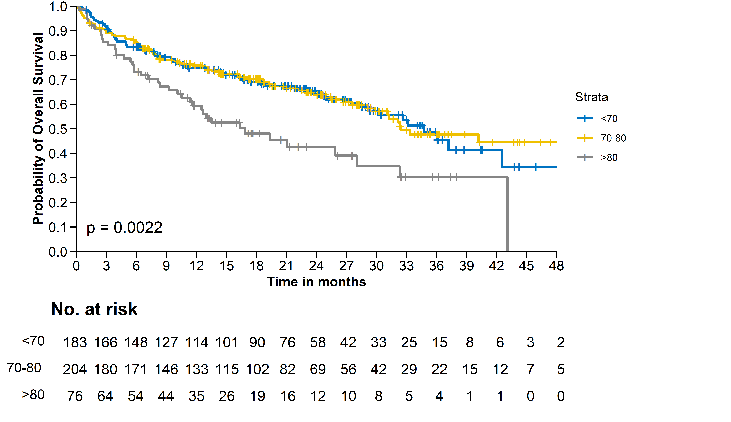
Plot.height = 0.7
Legend.position = „right“
Risk.table.width = 0.81

